Slide 1
Recruiting, Selection and Placement Patty Hickok, SPHR, GPHR, SHRM-SCP NHRMA 2015 President

Slide 2
Non-Discriminatory Considerations
Notes:
This morning, Sean went over a number of laws that affect human resources. From race, gender, religion, age, disability, pregnancy, and more. For us in HR, we always have to keep them in mind when performing our duties. Many of these laws will have an impact in recruiting and I will try to point them out to you as we go along.
Now, when you hire a new person or manager, do not make assumptions that they may already know all they need to know. Let me give you my personal example.

Slide 3
Agenda
Establishing Recruitment Objectives
Develop a Recruitment Strategy
Carry Out Recruitment Activities
Evaluate Recruitment Results

Slide 4
ESTABLISHING RECRUITMENT OBJECTIVES

Slide 5
Recruiting: Definition and Goals
Process of generating a pool of qualified applicants for organizational jobs
Find people that are a match for the job. You can train for skill but not behavior.
Identify people that are a match for the company and can help the organization achieve its mission and vision
Compliance
Notes:
Let’s get started – you all know recruiting. Either because that is or has been one of your duties or simply because you have applied for jobs and have been hired for one. Throughout your career you have seen recruitings go well and recruitings go bad and really bad. We always want to get not only enough candidates, but enough qualified ones.
The other one is ensuring that the person and the job is a good match. I remember a time where we hired a payroll person and our company had high volume processing. The person comes on the first day, goes to lunch and literally never came back! I have also had people that are a great match for the job, but they are not a good match for the organization.
And last but not least, we want to make sure that our process is compliant and sometimes that can be a challenge because we do all we can but the hiring managers do not.

Slide 6
Recruitment Objectives
_________________________________________
_________________________________________
_________________________________________
_________________________________________
_________________________________________
_________________________________________
_________________________________________
_________________________________________

Slide 7
Job Performance, Selection Criteria, and Predictors
Notes:
And you may ask yourself – but how do I know who to hire? The key is in being prepared and doing the homework in advance.
What is the job and what do we consider good performance?
What does the person need to achieve that good performance?
Based on that, what criteria do we come up with that could predict success on the job or good job fit?

Slide 8
Positive outcomes of good recruiting
Hiring the right people
A greater number of qualified applicants
Reputation as an employer of choice
Increased number of referrals of qualified candidates
Lower turnover
Increased number of diverse candidates
Higher job candidate-job offer acceptance rate
Open positions filled more rapidly

Slide 9
DEVELOP A RECRUITMENT STRATEGY

Slide 10
Recruitment Strategy
You already set up the recruitment objectives
Now develop a specific plan of action for attaining those objectives

Slide 11
Key Questions
Determining sourcing avenues
Determine start of recruitment campaign
Develop ways to reach the targeted individuals
Determine the recruitment message to communicate
Determine the type of recruiters needed
Determine nature of site visit (if applicable)
Determine what job offer entails
Type of individuals to target

Slide 12
Considerations
Economy
Types
Industry/Occupational: ex. mining, hospitality, oil and gas
Educational/Technical: certifications, degree type
Geographic: local, state, regional, national, international
Global: manufacturing in foreign countries
Employer Market
Employee Market
Notes:
Labor Market – one of the first things you have to look at is the economy and external environment. Are we in an employer market or an employee’s market? The difference is that typically when the economy is down unemployment is up. Therefore when you advertise a job you may get tons of applicants.
The other case is the opposite, and it can be tied to the economy or to the skill level: if the economy is great, we have lots of jobs available – we may not have enough people looking for work and therefore our pools will be small. Or the level of skill may be a factor. On my last two companies we hired for linguists – Parsi, Pashtu and a lot of middle eastern dialects. How many people that can legally work in the US have this skill?
Then we have the types of markets that can be by industry or occupation, by educational/technical areas, geographic, global. All those have to be taken in consideration because that is going to be another factor that is going to drive our decisions. Some organizations have manufacturing plants in foreign countries. I have a sister in Mexico that works for one of them, and it is interesting because she works in Mexico and is paid in pesos, but all her bosses are American.

Slide 13
CARRY OUT THE RECRUITMENT STRATEGY

Slide 14
STEP 1 | DEFINE THE JOB & CANDIDATE
Job
Candidate
Create job description
Title, salary, job grade
Reporting relationship
Essential functions of the job
Minimum requirements
Preferred requirements
Knowledge, skills and abilities (KSAs)
Work conditions
Resources:
O*net
Internet
Conformity or fresh perspective
Immediate job requirement or organizational career
Trained or trainable
Mobility or non-mobility

Slide 15
STEP 2 | JOB POSTING & APPLICATION PROCESS
Tailor to the media used
Posting may be different depending on the media used: newspaper, online, social media, professional organizations, etc.
Application process
Who, what, where, when and how
Position-specific information
Title, duties, location, salary range, submission process, closing date
Qualifications
Minimum and preferred requirements
Company
Company information, EEO statement, compliance statements (ex. E-Verify), drug free workplace, etc.
Approval Process
Varies per company
Some companies require posting to be approved by senior management

Slide 16
STEP 3 | SOURCING
Internal
External
Internal job posting
Employee database
Employee referrals
Employment Agencies
Job Fairs
Unions, prof. organizations
Colleges/Schools
Former employees
Resume database
Newspaper, radio, etc.
Online
Etc.

Slide 17
STEP 4 | SCREENING
Candidates have applied
Initial Screening
Automated if using applicant tracking system
Can use database management technique if large pool of candidates
Determine criteria to be used to screen (minimum requirements, preferred requirements)
Helps you identify who you need to focus on for the next step
Phone screening
Confirm skills, experience, and education
Check for phone skills if position requires phone work
Visualize the person while talking; consider whether they can communicate information and ideas sufficiently to meet job requirements
Listen for level of enthusiasm, any hesitancy, or sensitive areas
Ask about current status of job search
Ask what questions s/he has

Slide 18
STEP 5 | SHARE WITH HIRING MANAGER
Training
EEO considerations
Questions do’s and don’ts
Process
Company process clearly understood
Decision to interview
Company policy
Other: OFCCP if applicable
Importance of recordkeeping (dispositioning candidates)
Recordkeeping (dispositioning candidates)
Timely communication with HR re: interviewing, offers, etc.
Diversity considerations
Compliance
Coordinate with HR (depending on company process)

Slide 19
STEP 6 | INTERVIEW
Be prepared with pre-established questions
Coordinate interview if more than one interviewer
Build rapport with candidate
Ask open-ended questions
Verify employment history
Clarify any concerns with resume/application, gaps in employment, etc.
Ask additional questions to clarify a response
Be an active listener
Check for the non-verbal signs
Take notes
Ask candidate if they have questions and explain the next steps

Slide 20
Types of Interviews
Individuals
Individuals Sequentially
Panel Interview
Several interviewers meet with the candidate at the same time
Team Interview
Applicants are interviewed by the team members

Slide 21
Interview Biases
Stereotyping
First impression
Halo effect
Horn effect
Similar-to-me
Non-verbal bias
Cultural noise
Central tendency
Notes:
Type of Error Description
Halo effect - The tendency to evaluate a person high on all selection criteria even though the applicant may have been outstanding only on one part.
Horn effect- The inability to evaluate all or most of the candidates anywhere but in the middle.
Central tendency - Interviewer may not collect relevant information.
Similar to me - The tendency to evaluate higher those candidates who look, act, or have a background most like the interviewer.
First impression - Making the hiring decision within the first few minutes of the interview, instead of evaluating all the information from the entire interview.

Slide 22
STEP 7 | PREEMPLOYMENT TESTS
Work Sample Tests
Perform a simulated task that is a specified part of the target job. Ex. Create a spreadsheet
Situational Judgment Tests
Measure a person’s judgment in work settings
Cognitive Ability Tests
Measure an individual’s thinking, memory, reasoning, verbal, and mathematical abilities

Slide 23
Ability Tests
Psychomotor Tests
Measure dexterity, hand–eye coordination, arm–hand steadiness, and other factors
Physical Ability Tests
Measure an individual’s abilities such as strength, endurance, and muscular movement
Assessment Centers
Exercise composed of a series of evaluative tests used for selection and development

Slide 24
STEP 8 | SELECTION
Answers To Your Questions
Can-Do, Will-Do, and Best Fit Assessment
Rating/Ranking
Compare notes with others
Social Media
Interpreting The Data

Slide 25
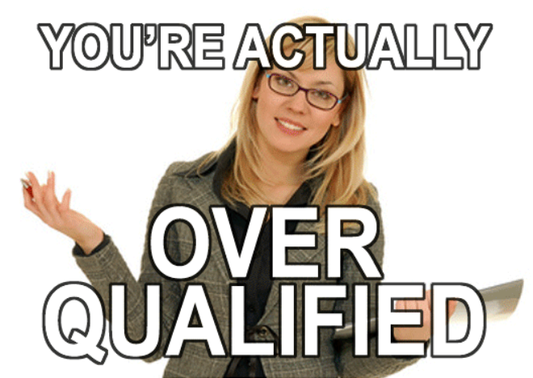
DIVERSITY CONSIDERATIONS

Slide 26
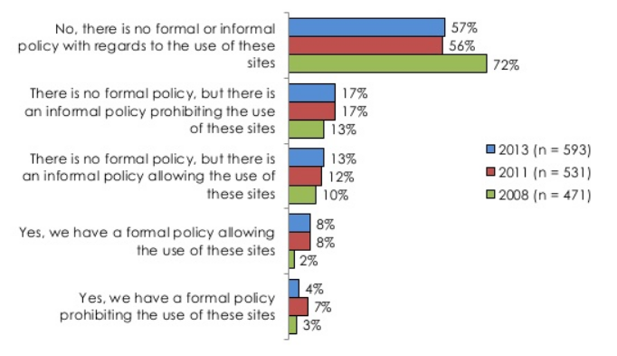
Social Media Policies
Source: http://www.slideshare.net/shrm/social-networkingwebsitesrecruitingselectingjobcandidatesshrm2013final

Slide 27
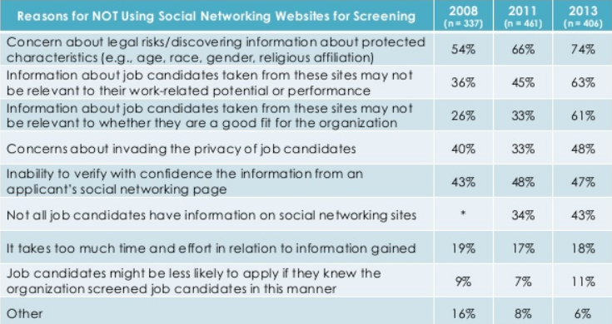
Social Media Use
Source: http://www.slideshare.net/shrm/social-networkingwebsitesrecruitingselectingjobcandidatesshrm2013final

Slide 28
If you are going to do it
Never ask for passwords.
In several states, employers cannot ask an applicant (or employee) for his or her social media password by law. In all 50 states, asking for an applicant’s (or employee’s) password creates a real risk of violating the federal Stored Communications Act. For this reason, employers should look only at content that is public.
Look later in the process.
Check social media profiles after an applicant has been interviewed, when his or her membership in protected groups is likely already known.
Have HR do it.
It is best if someone in HR, rather than a line manager, checks candidates’ social media profiles. The HR professional is more likely to know what he or she can and cannot consider.
Be consistent.
Don’t look at only one applicant’s social media profiles.
Consider the source.
Focus on the candidate’s own posts or tweets, not on what others have said about him or her. You may want to give the candidate a chance to respond to findings of worrisome social media content. There are impostor social media accounts out there.
Be aware that other laws may apply.
For example, if you use a third party to do social media screening, you are probably subject to the federal Fair Credit Reporting Act (and similar state laws). Also, some state laws prohibit adverse action based on off-duty conduct, except under narrow circumstances. -
Document decisions.
Print out the page containing social media content on which you base any hiring decision and record any reason for rejection, such as bad judgment. This protects you if damaging content has been deleted by the time a decision is challenged.
Source: http://www.shrm.org/publications/hrmagazine/editorialcontent/2014/0914/pages/0914-social-media-hiring.aspx#sthash.qZSy9LUg.dpuf

Slide 29
STEP 9 | REFERENCES
Organizational policy
Applicant documentation
Evaluation of reference information
Applicant responsibilities
Consistency
Reference checking procedures & forms

Slide 30
STEP 10 | CONTINGENT JOB OFFER
Contingent/Conditional Job Offer
It is a job offer stating terms and conditions of employment
Make sure that employment at-will statements are included
Make sure that candidate signs offer before proceeding with medical exams
Each company has different processes
Contingent on candidate passing
Background check – can be done before contingent offer, best practice is to do it after offer is extended
Drug Test – can be done before contingent offer, best practice is to do it after offer is extended
Fit for Duty – can only be done after contingent offer and only if related to the candidate’s abilities to perform the essential functions of the job

Slide 31
STEP 11 | PRE-EMPLOYMENT
Drug Tests
Fit for Duty – only after offer accepted
Background investigations
Employment verification
Education verification
Professional credentials verification
Criminal background
Sex offender
Credit history
Driving record
Etc.
Make sure to have candidate complete consent forms –watch out for state-specific forms or laws

Slide 32
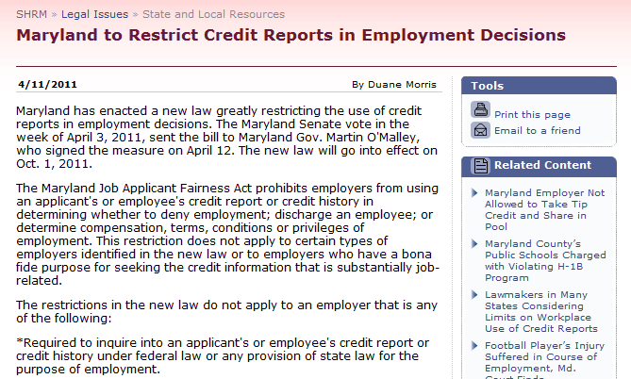
Legal Constraints on Background Investigations
Requirements for background investigation
Obtain a signed release from the applicant giving the employer permission to conduct the investigation
Ensure that background investigations are a part of business necessity
Firms that check applicants’ credit records must comply with the federal Fair Credit Reporting Act

Slide 33
Reasons for Previous Employment Checks
Verify Credentials/History
Verify Past Work/Future Potential
Evaluate Character
Prevent Unethical Conduct
Enhance Workplace Safety
Follow internal policy, contract requirements, etc.
Prevent Negligent Hiring

Slide 34
NEGLIGENCE
Negligent Hire
Employee unfit for hiring
Employer knew or should have known
Employer failed to make reasonable inquiry into applicant’s background or ignored the results
Employee posed a risk to others in the workplace (co-workers/public)
Negligent Retention
Employer knew or reasonably should have known unfitness after employment relationship starts
Employer fails to take further action

Slide 35
EXAMPLES OF NEGLIGENT HIRE
A hospital's failure to discover that a nurse was discharged by a prior employer because of unsafe handling of patients - lawsuit filed by a patient allegedly injured by the nurse;
A company's failure to discover a security guard's prior record of sex crimes - lawsuit filed by a customer allegedly molested by the security guard;
An apartment owner's failure to discover prior burglary convictions of a maintenance employee who had the pass key to all apartments - lawsuit filed by a tenant allegedly burglarized by the employee; and
The hiring of the an employee by a security firm which handled large sums of money without doing a thorough investigation of the employee's job history - lawsuit filed by a client from whom the employee allegedly stole a substantial sum of money.

Slide 36
STEP 12 |DISPOSITIONING CANDIDATES
Disposition Codes Examples:
Rejected
Education
Experience
Certifications
Driver license/CDL
Security clearance
Etc.
Withdrawal reasons
Did not return phone calls
No show for interview
No show for drug test
Accepted another offer
Salary
Location
Job conditions
Etc.
Not Reviewed
Hire
Interview
Rejected
Screened
Shared with Hiring Manager

Slide 37
NOTIFYING CANDIDATES
Notification depends on the organization
At a minimum contact the candidates that were interviewed
Rest of candidates
Automated via your applicant tracking system
Email
Letter
No communication (but what about company image?)

Slide 38
STEP 13 | ONBOARDING
General
Department
Job Specific
Advise what documents or data they need to bring for new hire paperwork
Benefits and new hire paperwork
Be prepared: computer, access, etc.
Company info
Policies
Procedures
Paydays
Holidays
Handbook
Building access
Meeting supervisor
Introduction to coworkers
Manager expectations
Dress code
Work and lunch hours
Department process: ex. Leave requests
Priorities
Systems
Timekeeping
Policies and procedures
Resources
Expectations
Projects

Slide 39
STEP 14 | FIRST DAY ON THE JOB
Have a plan for the first day and first week
Give clear instructions as to when, where and who to meet
Introduce to co-workers
Make sure employee has computer and system access ready
Assign a buddy

Slide 40
MEASURE AND EVALUATE RECRUITMENT RESULTS

Slide 41
MEASURING RECRUITING
Short-Term Considerations
Average time required to recruit applicants
Selection and acceptance rates of applicants
Cost per applicant
Quantity of applicants
Quality of applicants
EEO implications
Long-Term Considerations
Performance of hires
Turnover
Absenteeism per hire
Training costs

Slide 42
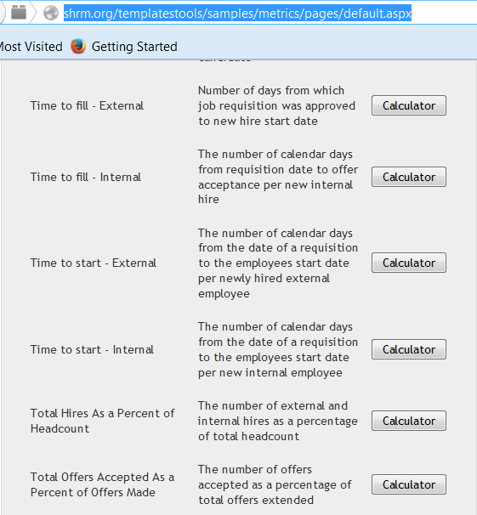
FORMULAS
http://shrm.org/templatestools/samples/metrics/pages/default.aspx

Slide 43
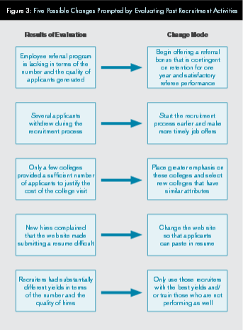
Possible Changes from Evaluating Recruiting
Source http://www.shrm.org/about/foundation/products/Documents/1109%20Recruiting%20EPG-%20Final.pdf

Slide 44
Current Trends
Performance of Now: – This includes custom content and mobile sites at the candidates fingertips immediately. Recruiting team will be forced to adopt a more consumer mindset or be left behind, suffering an employee and human capital short fall
Fully Engaged Recruiting: Social recruiting is no longer a stand alone resource. Companies combine social media, job boards, referrals and other systems to make a well-rounded and engaged recruiting program that doesn’t rely on a single solution for candidates.
Sourcing
Smart Hiring: Combining not just the power of big data but also technology to aid us in making better decisions with processes as well as recruitment. Smart hiring incorporates automation, technology and the latest analytics to help us make better use of our time, recruiting and long term business strategy. Smarter recruitment and hiring will be driven by integrated smart technology that truly works together driven by the performance of now
Mobile

Slide 45
RECRUITING IS IMPORTANT
Process of generating a pool of qualified applicants for organizational jobs
Find people that are a match for the job. You can train for skill but not behavior.
Identify people that are a match for the company and can help the organization achieve its mission and vision
Compliance

Slide 46
Resources
EEOC http://www.eeoc.gov//eeoc/newsroom/release/6-17-10a.cfm
Job Descriptions
SHRM - http://shrm.org/templatestools/samples/jobdescriptions/pages/bytitle.aspx
O*Net - http://www.onetonline.org/
Laws by state
SHRM http://apps.shrm.org/statuesregulations/ViewChart.aspx
Recruiting Certifications
AIRS https://www.airsdirectory.com/mc/training_certification.guid
Negligent Hire http://www.ptresearchinc.com/resources/downloads/Negligent%20Hiring.pdf
Social Media http://www.shrm.org/publications/hrmagazine/editorialcontent/2014/0914/pages/0914-social-media-hiring.aspx

Slide 47
Patty Hickok, SPHR, GPHR, SHRM-SCP hickok_p@yahoo.com
Thank You!

