Slide 2
Get Social!
Don’t forget to tell your classmates, friends and family about all the fun you are having at the HR Leaders of Tomorrow student conference.
Follow us on Twitter
Like us on Facebook
Join us on LinkedIn
#HRLEADERSOFTOMORROW

Slide 3
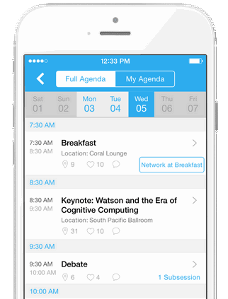
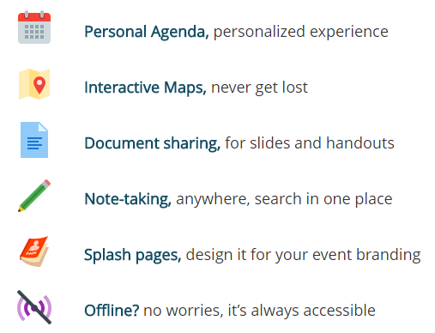
Download the Official Conference APP!
After downloading the app, sign up on Whova with the email address that you used to register for our event, or sign up using your social media accounts. If you are asked to enter an invitation code to join the event, please use the following invitation code: HRLEADERS

Slide 4
SHRM’s FREE Advocacy APP
Immediately take action on alerts using SHRM-provided templates
Connect to your state and federal lawmakers
Access SHRM A-Team Information
Quickly submit lawmaker meeting or event feedback
Engage with lawmakers and fellow HR professionals on social media
View legislative issue information on workplace issues
Stay up-to-date on all legislative updates facing the workplace
*Please be sure to accept push notifications
Get Involved by Downloading the APP Today!

Slide 5
SHRM CEO: Together Forward
Johnny C. Taylor, Jr., SHRM-SCP Joins SHRM as President & CEO.
On Monday, December 4th, SHRM officially welcomed Johnny C. Taylor, Jr., as its new President and Chief Executive Officer.
To learn more about our new CEO,
Watch his YouTube video: https://www.youtube.com/watch?v=cHVAJPUEHNM
Read his post on the SHRM blog:
https://blog.shrm.org/blog/embracing-courageous-hr-leadership-0
Johnny C. Taylor, Jr., SHRM-SCP
SHRM President & CEO

Slide 6
http://annual.shrm.org/

Slide 7
Career Resources
SHRM'S new members-only career resources can help fast-track your HR career development with easy-to-use tools that assess your HR skills and competencies and guide you toward further training and development.
Take the Competency Self-Assessment (CSA)
Use the Development Activity Wizard
Create a Competency Development Plan
To learn more about this new benefit and how to accelerate your career, visit shrm.org/careers

