Slide 1
Introduction to Compensation
Administration
Steve Hinds
UAA’s Center for Corporate and Professional Development

Slide 2
Compensation Clients
Access Battery
AlloSource
AMR Combs
Basic Earth Science
Boyd Distributing Company
Brownlee, Wallace, Armstrong and Bander
COPIC
Crystal Oil
Customer Insight
Denver Jet Center
Developmental Pathways
Dome Petroleum
Dynamic Materials
Elkhorn Construction
First Denver Mortgage
Ft. Worth Mortgage
General Packaging
Holy Cross Electric
Home Petroleum
HS Resources
Megapolitan Mortgage
Metropolitan Savings and Loan
Midland Manufacturing
Mountain Parks Electric
Ocean Pacific Children’s Wear
Pella Windows
Perlmutter Architects
Plastic Slip Sheets
Plavco Mortgage
Pumpkin Masters
Quickpen
Redifon Flight Simulation
Rose Safety Manufacturing
SAS Circuits
Transcontinental Oil
Van Schaack Real Estate, Mortgage and Insurance
Walnut Valley Bluegrass Music Association
Western Manufacturing

Slide 3
The environment for compensation
External
  Industry
  Competition
    Same industry
    Different industry
  Reason for people to seek the position
Internal
  Management thought on total compensation
  Ability to pay
  Thoughts on transparency
  What you want to accomplish through pay

Slide 4
What is Compensation?
Direct Compensation
  Salaries
  Wages
  Overtime
  Commissions
  Bonuses
  Profit Sharing
  Gainsharing
Indirect Compensation
  Pay for Time Not Worked
    Vacations
    Sick Leave
    PTO (Paid time off)
    Breaks
    Holiday
    Snow Days
  Insurance Plans
    Medical
    Dental
    Life
    Section 125 “Cafeteria”
  Security Plans
    401(k)
    Pension
    Disability Insurance
  Employee Services
    Educational Assistance
    Recreational programs

Slide 5
Successful Pay Systems are:
Legal compliance with laws and regulations
  Defensible
Understandable
Adaptable
Consistent
Fiscally Sound
Equitable
  Externally
  Internally
  Individually

Slide 6
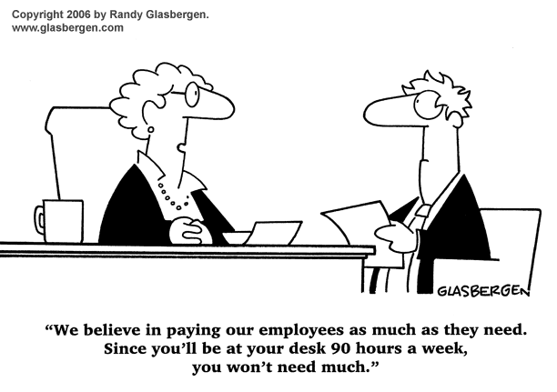

Slide 7
Laws Affecting Compensation
Fair Labor Standards Act
National Labor Relations Act
Equal Pay Act 1963
Title VII, Civil Rights Act of 1964
Age Discrimination in Employment Act
Americans with Disabilities Act
Lilly Ledbetter Fair Pay Act
OFCCP
  EO 11246
  Affirmative Action
Davis-Bacon Act
  What are prevailing rates?
McNamara-O’Hara Service Contract Act
Walsh-Healey Public Contracts Act
Sarbanes-Oxley
Notes:
The Davis-Bacon Act, which requires payment of prevailing wages and benefits to employees of contractors engaged in federal government construction projects;
The McNamara-O'Hara Service Contract Act, which sets wage rates and other labor standards for employees of contractors furnishing services to the federal government;
The Walsh-Healey Public Contracts Act, which requires payment of minimum wages and other labor standards by contractors providing materials and supplies to the federal government.

Slide 8
Excuses
“It is not our fault if they are bad negotiators for their own salaries.”
“We should be able to pay our workers what we want to pay them.”
“We can’t talk about pay at work.”
“I assume everything is fair because no one is complaining.”
“I’m not sure who checks our compensation system for equality, but I know it’s not me.”
“I’m not exactly sure what was used to decide this salary.”

Slide 9
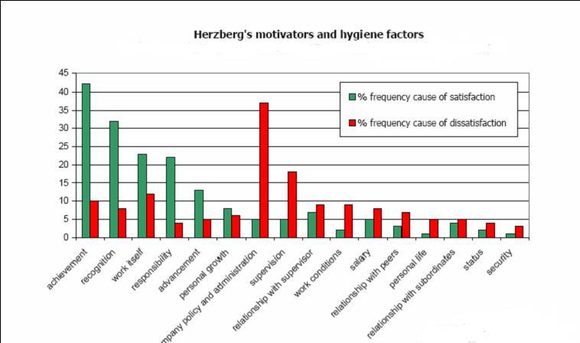
What really motivates people?

Slide 10
Money isn’t everything
If you are on the “other” side of Hertzberg, spend time there and fix issues. After issues are dealt with, develop a compensation system.
If you don’t fix those issues, a compensation system will provide temporary solutions at best.
Consider annual employee satisfaction surveys.
  Diagnose the problem
  Cost out fixes
  Publish results
  Install fixes

Slide 11
Compensation Design and Development – Design Phase
Compensation Philosophy
Job Evaluation Plan
Job descriptions/specifications
Salary survey data collection/Job Matching
  Multiple locations? Multiple surveys
Survey Analysis/Salary Ranges
Midpoint – Minimum & Maximum

Slide 12
Compensation Design and Development – Implementation Phase
Cost to implement
  Drill down
    Cost of your time and others to develop plan
    Cost for adjustments to place employees into the plan
Management approval
  Must have buy-in to compensation philosophy
  Be ready for sticker shock
Administrative guidelines
  What will you do in all situations
Employee communications
  Communicate with as much clarity as you can

Slide 13
Compensation Philosophy
By developing – forces discussion and agreement
76% of Hay Associates “America’s Most Admired Companies have a written pay philosophy
79% of companies without a pay philosophy “Employees don’t understand how pay is determined”
Communicate total compensation philosophy
  Pay will be based on performance
  Attract and retain - Support mission or culture change
  Maintain consistent pay practices across the organization
  How do we pay relative to the market
    Consider - who are your competitors?
    Which market(s) do you compete within?
    We will lead; We will lag; We will meet the market
  Establish external/internal/individual equity
  Every position will have job description and pay range
  Reward individual/organizational performance
  Pay fixed/variable
  Control payroll costs
  Revised annually

Slide 14
Compensation Philosophy
Our intent is to attract, develop and retain the most capable individuals within our industries
We provide a total compensation which is composed of base salary, benefits, incentive pay for individuals as well as potential bonus for group achievement.
We will
  strive to balance external, internal and individual equity through ongoing auditing of our compensation system
  establish salary structures which are based on (50th percentile, mean, weighted mean, etc.)
  data gathered from salary surveys in the areas in which we compete.
  revise salary structures annually based on the most current data available
  provide pay levels that are externally competitive among peers within our industry.
  provide salary adjustments which are based on accomplishment of measurable performance standards
  encourage individuals to increase their knowledge, capabilities and competencies and through that, to seek promotions within the organization. We will revise midpoints and compa-ratios based on those changes
  revise assignments and responsibilities within job descriptions on an ongoing basis.

Slide 15
Job Evaluation
Foundation for developing a pay plan
Describe pay differences based on objective criteria
Job Evaluation is done, either formal or informal
Determines the value of the job to the organization
Provides equal pay for jobs of equal worth
Some techniques are better than others
Evaluation Committee

Slide 16
Job Evaluation Methods - Puts jobs in a hierarchy
Many techniques, we concentrate on most common
Whole job ranking - simplest
Market Pricing - salary surveys determine
Classification - pre determined
Broadbanding - developing
Point Factor - qualitative - numeric values
Hay Plan and others – expensive and precise

Slide 17
Selecting the Right Plan
Plan may deteriorate over time - continually monitor
Top Management commitment - must understand time/resources
Number of jobs - more jobs take longer
Types of employee groups
Available staff
Amount of expertise - who can manage
Time
Money

Slide 18
Whole Job Ranking
Think of job as a whole - internal equity
Deck of cards approach
Equal to, higher than/lower than
Hierarchy
Janitor though top of the company
Starting position – least contributory
Ending Position – President
Consensus – not just averaging

Slide 19
Whole Job Ranking Exercise
Loop at position titles on next page
Rank the jobs from top to bottom to top
Write them down from bottom to top or top to bottom

Slide 20
Human Resource Generalist
Receptionist
Risk Management/Loss Control Manager
Payroll Clerk – Intermediate
Administrative Assistant – Senior
Compensation Analyst
Building Services/Custodian
President
Accountant – Intermediate
Human Resource Manager
Public Relations Specialist
Help Desk Technician

Slide 21
Whole Job Pros
Fast
Handles < 30 jobs easily
Little commitment of time/resources
No consultant required
Do not need job descriptions
Needs someone who knows the jobs
No data to support conclusions

Slide 22
Whole Job Cons
Subjective
Hard to defend
Unclear to employees
Does not establish price of job

Slide 23
Job Descriptions
Examines the job, not the incumbent
Includes regular and important features
Is clear, concise and accurate
Is a snapshot at one point in time
Must be kept current
Should contain measurable performance standards

Slide 24
Market Pricing
Establish hierarchy based on External data
Market ranks the jobs
If fortunate, you can match 30-50% of jobs within the market
Benchmark jobs in each job family
Slot jobs that don't match through whole job ranking or other system (Broadbanding)

Slide 25
Market Price Pros
Easier to recruit and retain employees
  Market is setting the price of jobs
Understandable; easy to communicate
Supports a competitive philosophy
Development and maintenance time minimal

Slide 26
Market Price Cons
Heavily dependent upon survey data
  Difficult to find enough solid data
  Survey reports vary
  Survey data must be up-to-date and valid
Pay decisions based on what others do
You will not find all of your jobs in a survey
Some benchmark positions may be overpriced
If market decreases, what do you do?
May not be affordable

Slide 27
Salary Surveys
Do they cover your usual recruiting area?
Defined methodology
  Detailed job descriptions?
  Full time only?
  80% match in duties – do not just match title
  Base wages or total compensation?
  Exclude
    Unique situations; Part time; Shift Premium
  Definitions
  Insufficient data
  Can you get custom data?
  When was data collected?
    Aging results

Slide 28
Survey Data
Number of companies
Number of incumbents
Simple Average
Weighted Average
Percentiles
Rate ranges

Slide 29
Statistical Functions
Value
20,010
19,577
19,410 | 75%
18,789
18,206
18,003 | Median (Half way into data)
17,899
17,253
16,997 | 25%
16,448
15,878

Slide 30
Means or averages
Value
20,010
19,577
19,410
18,789
18,206
18,003
17,899
17,253
16,997
16,448
15,878
18,042.73 | Mean – simple average

Slide 31
Weighted Mean or Average
Value | Occurrences | Product
20,010 | 1 | 20,010
19,577 | 3 | 58,731
19,410 | 6 | 116,460
18,789 | 3 | 56,367
18,206 | 4 | 72,824
18,003 | 2 | 36,006
17,899 | 7 | 125,293
17,253 | 4 | 69,012
16,997 | 7 | 118,979
16,448 | 9 | 148,032
15,878 | 1 | 15,878
 | 47 | 837,592 | = 837,592/47
 | Weighted Mean |  | 17,821.11

Slide 32
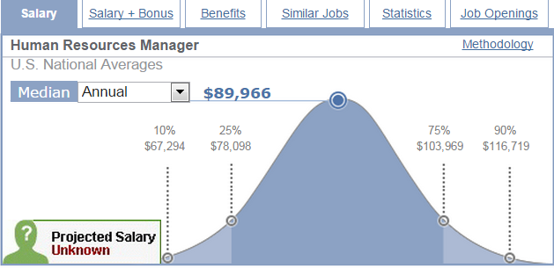
Salary.com

Slide 33
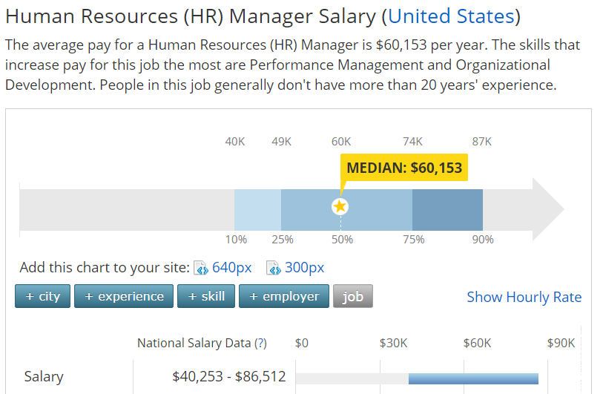
Payscale.com
Notes:
The average pay equals the Median???

Slide 34
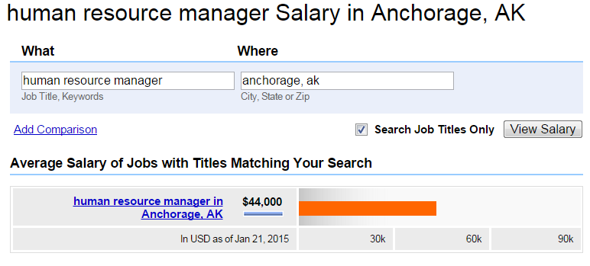
Indeed.com

Slide 35
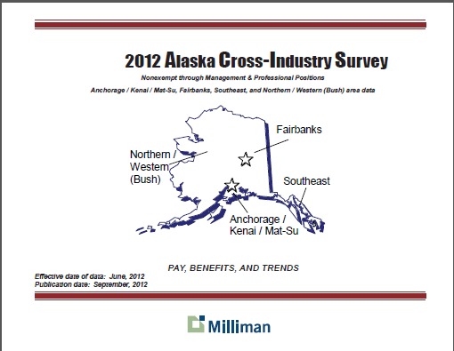
Milliman

Slide 36
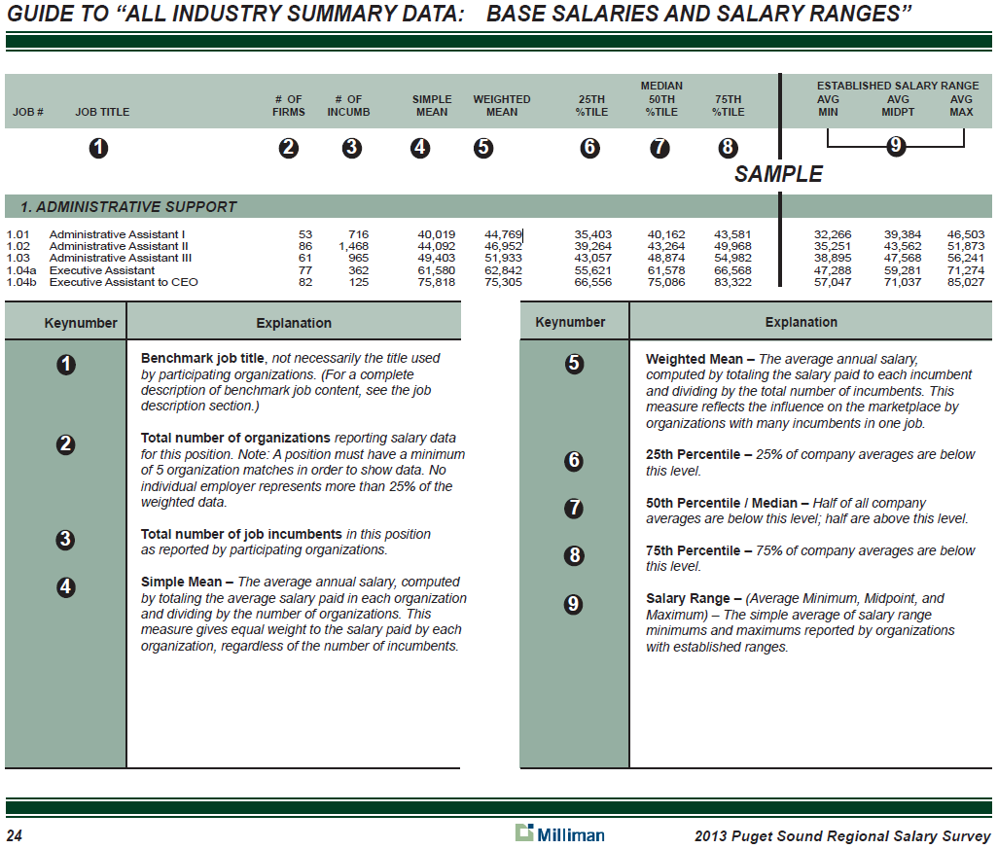

Slide 37
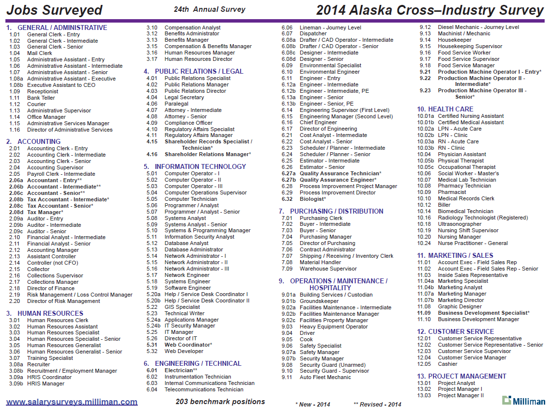

Slide 38
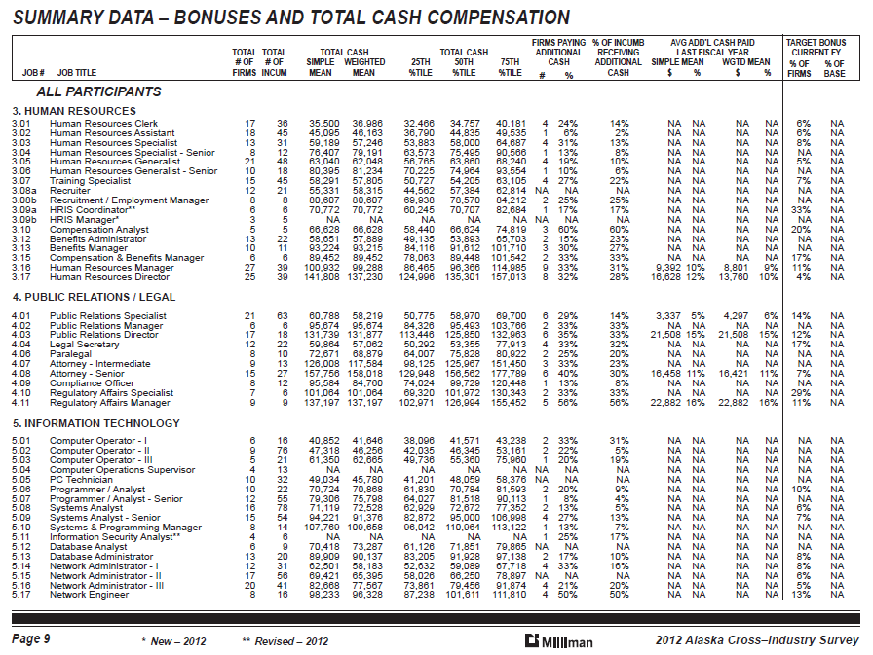

Slide 39
Problems with survey data
To few participants
Not focused on your recruiting area
Different information available to employees
  Salary.com
  Payscale.com
  Glassdoor.com
  From recruiters
  Industry associations

Slide 40
Market Pricing Exercise
Based on your Compensation Philosophy, determine market prices for selected jobs
  1.09 – Receptionist
  2.05 – Payroll Clerk – Intermediate
  1.07 – Administrative Assistant – Senior
  3.10 – Compensation Analyst
  2.07 – Accountant – Intermediate
  5.12 – Database Analyst
  3.05 – Human Resource Generalist
  2.19 – Risk Management/Loss Control Manager
  2.02 – Accounting Clerk – Intermediate
  3.16 – Human Resource Manager
  4.01 – Public Relations Specialist
Notes:
Hand out pages with comp data from 2012
Have them pick out wages

Slide 41
Salary Grades – For the Job
For the job, not the individual
Purpose of Grades
  Administration
  Cost control
  Clear career progression/paths
  Jobs belong together
  Jobs belong in different grades

Slide 42
Salary Range
For the individual in the job
Range has a structure
Based on the midpoint of the job
The Midpoint is where every employee who is doing 100% of their job should be
The Minimum is where you start looking at wage for hiring new or newly promoted employees
The Maximum is that – regardless of who is in that particular job - that should be the absolute maximum that you should pay
Range can be broken down into sub-ranges for precision

Slide 43
Compa-Ratio
Salary divided by midpoint
  Midpoint = $2,000
  Salary = $1,800
What is Compa-Ratio for that midpoint?
    1800 / 2000= .9
  Compa-Ratio = .90 or 90%
  2200 / 2000 = 1.10 or 110%
This tells you range penetration – how far the salary is into the range

Slide 44
Salary Range
Compa-Ratio
Maximum
120% of midpoint
$2,400
Job & performance mastery
112 % of midpoint
$2,240
Consistent competence
104% of midpoint
$2,080
Fully satisfactory
Midpoint
100% of midpoint
$2,000
Approaching competence
96% of midpoint
$1,920
Developing
88% of midpoint
$1,760
Entry level
Minimum
80% of midpoint
$1,600

Slide 45
Build Salary Grades from midpoints
Start with grade 1 midpoint with 10% increase
Grade 5 - $2,196
Grade 4 - $1,995
Grade 3 - $1,815
Grade 2 - $1,650
Grade 1 - $1,500

Slide 46
Building Grades
 | Grade 1 | Grade 2 | Grade 3 | Grade 4 | Grade 5 | Grade 6 | Grade 7 | Grade 8 | Grade 9 | Grade 10 | Grade 11
Maximum | 10.38 | 11.42 | 12.57 | 13.82 | 15.20 | 16.72 | 18.40 | 20.24 | 22.26 | 24.49 | 26.94
Midpoint | 8.65 | 9.52 | 10.47 | 11.52 | 12.67 | 13.94 | 15.33 | 16.86 | 18.55 | 20.41 | 22.45
Minimum | 6.92 | 7.62 | 8.38 | 9.21 | 10.14 | 11.15 | 12.26 | 13.49 | 14.84 | 16.32 | 17.96
10.00% | Increase between grades
 | Grade 1 | Grade 2 | Grade 3 | Grade 4 | Grade 5 | Grade 6 | Grade 7 | Grade 8 | Grade 9 | Grade 10 | Grade 11
Maximum | 1,800 | 1,980 | 2,178 | 2,396 | 2,635 | 2,899 | 3,189 | 3,508 | 3,858 | 4,244 | 4,669
Midpoint | 1,500 | 1,650 | 1,815 | 1,997 | 2,196 | 2,416 | 2,657 | 2,923 | 3,215 | 3,537 | 3,891
Minimum | 1,200 | 1,320 | 1,452 | 1,597 | 1,757 | 1,933 | 2,126 | 2,338 | 2,572 | 2,830 | 3,112
10.00% | Increase between grades
 | Grade 1 | Grade 2 | Grade 3 | Grade 4 | Grade 5 | Grade 6 | Grade 7 | Grade 8 | Grade 9 | Grade 10 | Grade 11
Maximum | 21,600 | 23,760 | 26,136 | 28,750 | 31,625 | 34,787 | 38,266 | 42,092 | 46,302 | 50,932 | 56,025
Midpoint | 18,000 | 19,800 | 21,780 | 23,958 | 26,354 | 28,989 | 31,888 | 35,077 | 38,585 | 42,443 | 46,687
Minimum | 14,400 | 15,840 | 17,424 | 19,166 | 21,083 | 23,191 | 25,510 | 28,062 | 30,868 | 33,954 | 37,350
10.00% | Increase between grades

Slide 47
Broadbanding
Consolidating salary grades
  Rather than 15 grades, Broadbanding may only list 5-6
Ranges are significantly larger
Bands contain “Control Points”
Those utilizing
  Bank of America
  Baxter Healthcare
  Boeing
  Eli Lilly
  General Electric
  Georgia-Pacific
  IBM
  Merrill Lynch
  Sears, Roebuck
  The Scotts Company
  Central Intelligence Agency
  General Accounting Office
  Department of Commerce
  Department of the Air Force
  Department of the Navy
  Transportation / Federal Aviation Administration
  Treasury / Internal Revenue Service
  Treasury / Office of the Comptroller of the Currency
  City of Charlotte, North Carolina
  State of South Carolina
  State of Virginia

Slide 48
Broadbanding
Traditional Grades
Broadbanding
4,000
3,500
3,000
2,500
2,000
1,500

Slide 49
Broadbanding Advantages
Fewer levels
Less emphasis on hierarchy
More managerial freedom
Managers have more flexibility to move employees through ranges
Avoids conflict with employees concerning job grades
Allows more movement within ranges in flat organizations
Requires commitment to training and development

Slide 50
Broadbanding Disadvantages
Lack of career growth
Requires excellent communications
Requires high level of trust
Requires continual development to increase in the band
Too much latitude in light of Ledbetter

Slide 51
Point Factor Method
Determine factors, degrees and point values
Analyze jobs compared to the degree within each factor
  Factor = education
  Degree = level of education required
Assign points to each degree
Calculate totals for each job
Arrange jobs from lowest to highest points
Rather than having grades or bands…
  Each individual position has it’s own midpoint, minimum and maximum based on the content of the job.

Slide 52
Point Factor Advantages
Objective
Based on market data
  Must have solid market data
Defensible
Handles many jobs
Adaptable
With good data, you can project midpoints and ranges per position
Can compare “apples” with “oranges”

Slide 53
Point Factor Disadvantages
Takes time
Needs trained staff
Takes time and understanding of system to communicate
Once employee understands the system, they buy in
If you need a consultant to develop all of it, it may be expensive

Slide 54
Point Factor - Factors
Education
Experience
Supervision Received
Equipment Utilized
Contact
Confidentiality
Supervision Given
Effect of Error
Problem Solving
Supervision Given
Number Supervised
Must use same factors externally as internally
Each factor gets “multiplier” based on importance of factor

Slide 55
Education
  1 - Some High School
  2 - General High School
  3 - HS Plus job related course work
  4 - Certificate/Diploma/Journeyman or
  equivalent
  5 - 2 year Associates Degree
  6 - Complete college resulting in Bachelors
  7 - Undergraduate degree with additional
  professional development classes
  8 - Masters level degree
  9 - Ph.D.
Each level gets 40 points

Slide 56
Experience
1 - Up to 3 months
2 - Over 3 months up to 6 months
3 - Over 6 months up to 12 months
4 - Over 1 year up to 2 years
5 - Over 2 years up to 3 years
6 - Over 3 years up to 5 years
7 - Over 5 years up to 8 years
8 - Over 8 years
Each level gets 40 points

Slide 57
How to use Point Factor
Use the Job Description
Watch out for over evaluating!
Always use the factors
Use bracketing
  Is Level 1 too low? Go to Level 2
  Progress up until the Level doesn’t fit
After evaluating a few positions, go back and check for consistency
Use the same evaluators externally as you use internally
You will not always have all the data that you need about survey positions

Slide 58
Point Factor Regression Data
Use evaluation system for external surveys
Evaluate “benchmark” positions
Complete regression analysis on findings
Check correlation coefficient for regression
Better than .95 is statistically reliable
Project regression line, slope and intercept

Slide 59
Scattergram of survey
Dollars vs points

Slide 60
Regression Line

Slide 61
From Milliman 2007 Alaska Wage Survey |  | # | # | Simple | Weighted | 25th | 50th | 75th |  |  |  |  |  |  |  |  |  |  |  | TOTAL
 |  | Firms | Incum | Mean | Mean |  |  |  |  | 40 | 40 | 10 | 30 | 5 | 35 | 35 | 20 | 30 |  | POINTS
 |  |  |  |  |  |  |  |  |  | Ed | Exp | Eq | Ct | Cnfid | Sup | Prob | Error | Sup
 |  |  |  |  |  |  |  |  |  |  |  |  |  |  | Rec | Solv |  | Give
Building Services / Custodian |  | 9 | 164 | 31047 | 27620 | 26443 | 28107 | 37388 |  | 1 | 2 | 1 | 1 | 1 | 1 | 1 | 1 | 0 |  | 255
Receptionist |  | 18 | 60 | 32103 | 28649 | 27253 | 31034 | 34341 |  | 2 | 3 | 2 | 1 | 1 | 1 | 1 | 1 | 0 |  | 345
Pharmacy Technician |  | 7 | 74 | 34536 | 35605 | 32478 | 35097 | 36787 |  | 3 | 4 | 2 | 1 | 2 | 2 | 2 | 2 | 0 |  | 520
Payroll Clerk - Intermediate |  | 25 | 29 | 42695 | 42477 | 36712 | 44922 | 48547 |  | 4 | 5 | 2 | 2 | 3 | 2 | 2 | 2 | 0 |  | 635
Administrative Assistant - Senior |  | 25 | 371 | 45235 | 40786 | 37762 | 44589 | 51304 |  | 3 | 5 | 2 | 2 | 2 | 3 | 2 | 2 | 1 |  | 655
Compensation Analyst |  | 5 | 5 | 52669 | 52669 | 40697 | 46634 | 67660 |  | 6 | 6 | 3 | 2 | 3 | 3 | 3 | 3 | 1 |  | 885
Accountant - Intermediate |  | 17 | 62 | 52692 | 52613 | 48759 | 52250 | 56852 |  | 6 | 6 | 3 | 2 | 2 | 3 | 3 | 3 | 1 |  | 880
LAN/WAN Administrator - II |  | 13 | 57 | 66502 | 59012 | 61829 | 68069 | 75706 |  | 6 | 7 | 3 | 2 | 2 | 3 | 3 | 3 | 1 |  | 920
Public Relations Specialist |  | 13 | 16 | 58724 | 58355 | 54200 | 57021 | 65220 |  | 6 | 5 | 3 | 5 | 4 | 4 | 4 | 4 | 1 |  | 1030
Human Resource Generalist |  | 16 | 22 | 55997 | 56481 | 49920 | 57001 | 61338 |  | 6 | 6 | 3 | 4 | 4 | 4 | 4 | 4 | 3 |  | 1100
Risk Management / Loss Control Manager |  | 6 | 7 | 77945 | 76021 | 71902 | 77074 | 86412 |  | 7 | 8 | 3 | 4 | 5 | 5 | 5 | 5 | 3 |  | 1315
Human Resource Manager |  | 24 | 26 | 86376 | 86291 | 70851 | 82505 | 99947 |  | 7 | 8 | 3 | 5 | 5 | 5 | 5 | 5 | 4 |  | 1375
Pearson (Corelation coefficient) | 0.9737
Slope | 48.76
Intercept | 11,094.66

Slide 62
Using Regression
Regression Analysis give you two points of data
  Slope – 48.76
  Intercept – 11,094.66
To find a midpoint on a position
  Point/Factor analysis of position
  Determine total points
  Multiply points times Slope
  Add in Intercept
  Result is midpoint
  Construct range around midpoint

Slide 63
Developing Midpoint
Evaluate internal position
  Human Resource Manager – 1,335 points
Slope – 63.35185
Intercept – 11,917.79
Midpoint = (Points * Slope) + Intercept
Midpoint = (1,335*63.35185)+11,917.79
Midpoint = (84,574.72) + 11,917.79
Midpoint = $95,669.38

Slide 64
Salary Range
Human Resource Manager
Compa-Ratio
Maximum
120% of midpoint
$114,803.30
Job & performance mastery
112 % of midpoint
$107,149.70
Consistent competence
104% of midpoint
$99,496.15
Fully satisfactory
Midpoint
100% of midpoint
$95,669.38
Approaching competence
96% of midpoint
$91,842.60
Developing
88% of midpoint
$84,189.05
Entry level
Minimum
80% of midpoint
$76,535.50

Slide 66
Installing a new system
Select job evaluation system
Develop position descriptions
  Capture information for every factor
Use point factor to develop regression line for the market
Develop slope and intercept
Evaluate internal positions
Project midpoints and ranges
Insert individuals into chart with compa-ratios
Cross reference with performance levels
Determine where the individual should be based on performance and present compa-ratio

Slide 67
Vision
Incentive Comp
Mission
Pay for Performance
`
Values
Conduct Review
Strategic Plan
Components
of
Performance
Management
Plan for Review
Tactical Plan
Feedback
Department
Plan
Documentation
Tracking System
Job Descriptions
Developing PA Process
Performance Standards
Goals and Objectives

